Slide 1
CHAPTER 4
Dummy Variable Regression Models

Slide 2
Outline
1. Multiple regression analysis with qualitative information
1.1. The nature of qualitative information
1.2. Describing Qualitative Information
1.3. A single dummy independent variable
1.4. Interaction with dummy variables
1.5. Dummies for Multiple Categories
2. Testing for Differences Across Groups
2.1. The Chow test
2.2 The use of dummy variables
3. The dummy variables in seasonal analysis
4. Piecewise linear regression

Slide 3
1. 1.The Nature of Qualitative Information
Sometimes we can not obtain a set of numerical values for all the variables we want to use in a model.
Examples:
Gender may play a role in determining salary levels
Different ethnic groups may follow different consumption patterns
Educational levels can affect earnings from employment

Slide 4
1. 1.The Nature of Qualitative Information
It is easier to have dummies for cross-sectional variables, but sometimes we do have for time series as well.
Examples
Changes in a political regime may affect production
A war can have an impact on economic activities
Certain days in a week or certain months in a year can have different effects in the fluctuation of stock prices
Seasonal effects are often observed in demand of various products

Slide 5
1.2. Describing Qualitative Information
A dummy variable (binary variable) is a variable that takes on the value 1 or 0.
→ The name of dummy variable should indicate the event with the value one.
Example: (see Table 3.1):
female (= 1 if are female, 0 otherwise),
married (= 1 if are married, 0 otherwise), etc

Slide 6
Table 3.1 A Partial Listing of the Data in WAGE1.RAW
person | wage | educ | exper | female | maried
1 | 3.10 | 11 | 2 | 1 | 0
2 | 3.24 | 12 | 22 | 1 | 1
3 | 3.00 | 11 | 2 | 0 | 0
4 | 6.00 | 8 | 44 | 0 | 1
5 | 5.30 | 12 | 7 | 0 | 1

Slide 7
1.3. A single dummy independent variable
A simple model with one continuous variable (x) and one dummy (d) :
This can be interpreted as an intercept shift:
→If d = 0, then
If d=1, then
→ The case of d = 0 is the base group.

Slide 8
Example of δ₀ > 0
y
y = (β₀ + δ₀) + β₁x
d = 1
slope = β₁
{
δ₀
d = 0
}
y = β₀ + β₁x
β₀
x

Slide 9
Example
Model of wage determination
H0: there is no difference between earnings of men and women:
H1: There is discrimination against women:
Control variables
wage= average hourly earnings
female=1 if female
educ =years of education
exper= years potential experience
tenure= years with current employers

Slide 10
Example
Output

Slide 11
Example- interpreting the output
Negative intercept→ the intercept for men→ is not very meaningful because no one has zero values of all educ, exper and tenure in the example.
Negative coefficient on female → the average difference in hourly earnings between a woman and a man, given the same levels of educ, exper and tenure → The woman earns, on average USD1.81 less per hour than the man.
The intercept for men: , for women:

Slide 12
Example
Do not include male and female in a model with an intercept → dummy variable trap due to perfect collinearity.
Notes:
.

Slide 13
Example
There is no dummy variable trap if we do not have an overall intercept.
Notes:
.

Slide 14
Example
Reestimate the wage equation using log(wage) as the dependent variable and adding quadratics in exper and tenure.

Slide 15
Example- Interpreting output
The coefficient on female implies that for the same levels of educ, exper, and tenure, women earn about 29.7% less than men

Slide 16
1.4. Interactions with Dummies
An interaction term is an independent variable that is the product of two other independent variables. These independent variables can be continuous or dummy variables
Y_{t} = β₁ + β₂X_{t} + β₃Z_{t} + β₄X_{t}Z_{t} + e_{t}
In this model, the effect of X on Y will depend on the level of Z.
In this model, the effect of Z on Y will depend on the level of X.

Slide 17
1.4. Interactions with Dummies
Can also consider interacting a dummy variable, d, with a continuous variable, x
y = β₀ + δ₁d + β₁x + δ₂d*x + u
If d = 0, then y = β₀ + β₁x + u
If d = 1, then y = (β₀ + δ₁) + (β₁+ δ₂) x + u
This is interpreted as a change in the slope

Slide 18
Example of δ₀ > 0 and δ₁ < 0
y
y = β₀ + β₁x
d = 0
d = 1
y = (β₀ + δ₀) + (β₁ + δ₁) x
x

Slide 19
Example
Test whether the return to education is the same for men and women, allowing for a constant wage differential between men and women).

Slide 20
Example
Output

Slide 21
Example
H0: Return to education is the same for men and women,
Interpretation of output: The estimated return to education for men is 7.72% and for women is (7.72-0.00)%. The difference, -0.00% is not economically large nor statistically significant (t=-0.00).→ There is no evidence against the hypothesis that the return to education is the same for men and women.

Slide 22
Example
Reestimate the wage equation using log(wage) as the dependent variable and adding quadratics in exper and tenure.

Slide 23
Example
Interpreting output: The estimated return to education for men is 8.2% and for women is 0.082-0.0056= 7.6%. The difference -0.56% is not economically large nor statistically significant. → There is no evidence against the hypothesis that the return to education is the same for men and women.

Slide 24
Example
H0: and
Output
test female= femaleeduc=0
( 1) female - femaleeduc = 0
( 2) female = 0
F( 2, 518) = 34.33
Prob > F = 0.0000
H0 is rejected → a constant wage differential between women and men is allowed!

Slide 25
1.5.Dummies with Multiple Categories
We can use dummy variables to control for something with multiple categories
Estimate a model that allows for differences among four groups: primary, secondary, tertiary, BSc, MSc
D1= 1 if primary; 0 otherwise
D2= 1 if secondary; 0 otherwise
D3= 1 if tertiary; 0 otherwise
D4 = 1 if BSc; 0 otherwise
D5 = 1 if MSc; 0 otherwise

Slide 26
1.5.Dummies with Multiple Categories
Any categorical variable can be turned into a set of dummy variables
Because the base group is represented by the intercept, if there are n categories there should be n – 1 dummy variables
If there are a lot of categories, it may make sense to group some together
Example: top 10 ranking, 11 – 25, etc.

Slide 27
1.5.Dummies with Multiple Categories
So we estimate:
Y=β₁+β₂X₂+ a₁ D₂+a₂D₃+a₃D₄+a₄D₅+u
Note that one dummy (in this case D1) is excluded from the model in order to avoid dummy variable trap.
Consider various cases,
i.e. D2=1, D3=D4=D5=0 etc.

Slide 33
Example-Seasonal Dummy Variables
Depends on the frequency of the data
Quarterly – 4 dummies – DQ1, DQ2, DQ3, DQ4
Monthly – 12 dummies – one for each month
Daily – 5 dummies – Dmon, Dtue, Dwed etc.
Again we either exclude one and include a constant (always better) or if we use all we never include a constant (dummy variable trap).

Slide 34
2. Testing for Differences Across Groups
Testing whether a regression function is different for one group versus another:
2.1. The Chow test.
2.2. Test for the joint significance of the dummy and its interactions with all other x variables

Slide 35
Example
Whether the same regression model describes college grade point averages for male and female college athletes.
Where cumgpa= cumulative gpa
sat= SAT score
hsperc= high school rank percentile
tothrs= total hours of college course

Slide 36
The Chow test
Suppose we have 2 groups, g=1 and g=2.
We test whether the intercept and all slopes are the same across the two groups.
k variable model

Slide 37
The Chow test
RSS1 = the sum of squared residuals for group 1 (n1 observation).
RSS2 = the sum of squared residuals for group 2 (n2 observation).
RSS = the sum of squared residuals for the whole sample (n observation).

Slide 38
The Chow test
~
~
~
~
k variable model

Slide 39
The Chow Test
F-statistic with the df of (k, n-2k)
F-statistic us called the Chow statistic
If
→ H0 is rejected.

Slide 40
The Chow Test- Example
Output for female =1

Slide 41
The Chow Test- Example
Output for female =0

Slide 42
The Chow Test- Example
Output for the whole sample

Slide 43
The Chow Test
F-statistic with the df of (4, 724)
F-statistic us called the Chow statistic
→ H0 is rejected.

Slide 44
Test for the joint significance of the dummy and its interactions with all other x variables
Model
Null hypothesis:

Slide 45
Example-Output
Look at the t-statistics of female and its interactions!

Slide 46
Example-Output
The coefficients on female, female*sat, female*tothrs are significant →H0 is rejected.
Estimate the restricted model by dropping female and its interactions →
Notes:
Rur+ 0.2537

Slide 47
Example-Output
test female= femalesat= femalehsperc= femaletothrs=0
( 1) female - femalesat = 0
( 2) female - femalehsperc = 0
( 3) female - femaletothrs = 0
( 4) female = 0
F( 4, 724) = 4.42
Prob > F = 0.0015

Slide 49
3. The dummy variables in seasonal analysis
Many economic time series based on monthly or quarterly data exhibit seasonal patterns. Examples:
→ Sales of department stores at Christmas and other major holiday times
→ Demand for money by households at holiday times
→ Demand for ice cream and soft drinks during summer
→ Prices of crops right after harvesting season, demand for air travel, etc..

Slide 50
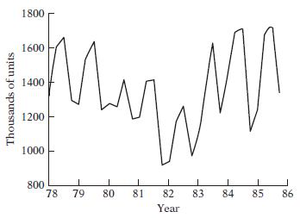
3. The dummy variables in seasonal analysis
Seasonal variables:
D1 = 1 if Q2, 0 otherwise
D2 = 1 if Q3, 0 otherwise
D3 = 1 if Q4, 0 otherwise
Regression model
Regression model with interactions:
Y= sales of refrigerators (in thousands)

Slide 51
3. The dummy variables in seasonal analysis
Q1:
Q2:
Q3:
Q4:

Slide 52
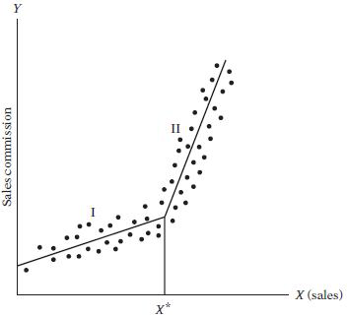
4. Piecewise Linear Regression
Example: Hypothetical relationship between sales commission and sales volume. (Note: The intercept on the Y axis denotes minimum guaranteed commission.)
where
Yi = sales commission
Xi = volume of sales
generated by the sales person
X* = threshold value of sales
D = 1 if Xi > X∗
= 0 if Xi < X∗

Slide 53
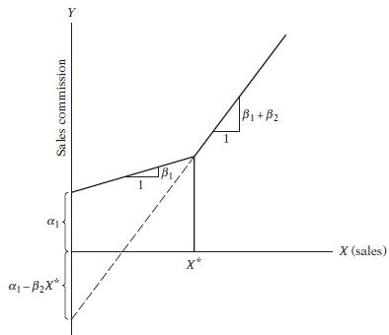
4. Piecewise Linear Regression
Parameter of the piecewise linear regression.
gives the slope of the regression line in segment I,
gives the slope of the regression line in segment II
A test of the hypothesis that there is no break in the regression
at the threshold value X* can be conducted easily by noting the statistical significance of the estimated differential slope
coefficient β2s of the piecewise
linear regression.

Slide 54
END OF CHAPTER 4

